Slide 1

Mentexa: Mental Health Self-Check Portal
Proposal by: Pritam Thapa, Avash Mainali, Isha Shrestha
Malpi International College, Pokhara University.
Self-care begins with self-awareness.
Date: May 11, 2025.

Slide 2

Introduction to Mentexa
Mental Health Trends
Portal Features
Rising challenges among students and young adults.
PHQ-9 & GAD-7 self-assessment tests
Mood tracking tool
Motivational image gallery
Privacy Emphasis
Data stored locally using browser localStorage.

Slide 3

Identifying the Problem
Access Barriers
Limited mental health support availability.
Privacy Concerns
Stigma and data sharing deter help-seeking.
Tool Deficiency
Lack of simple, anonymous self-assessment tools.
Tracking Need
Desire for daily mood logging without data exposure.

Slide 4
Project Objectives
Functional Goals
User Engagement
Responsive frontend-only portal
Login simulation to restrict mood access
PHQ-9 and GAD-7 tests with instant feedback
Motivational image gallery
Mood tracker with local history storage
Promote awareness for students and young adults

Slide 5





Development Methodology
Planning
Define features based on user needs and research.
Design
Create wireframes and ensure accessibility.
Development
Build with HTML, CSS, and JavaScript.
Testing & Review
Validate functionality and refine via feedback.

Slide 6





Use-Case Diagram Overview
User
Self Tests
Mood Logging
Primarily students and young adults.
PHQ-9 and GAD-7 assessments.
Track daily mood entries locally.
Gallery
Motivational pictures to encourage users.

Slide 7
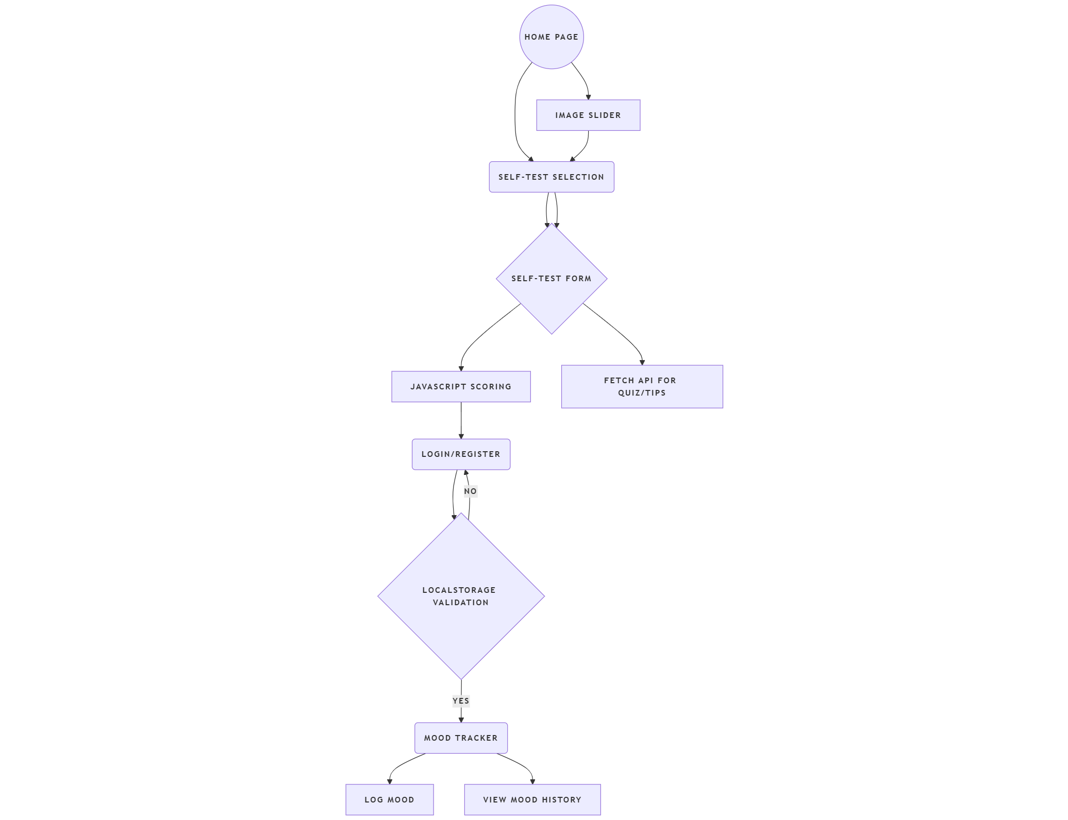
Project Flow Chart
flowchart TD
A[Home Page] --> B[Image Slider]
A --> C[Self-Test Selection]
C --> D{Self-Test Form}
D --> E[JavaScript Scoring]
D --> F[Fetch API for Quiz/Tips]
E --> G[Login/Register]
G --> H{LocalStorage Validation}
H -- Yes --> I[Mood Tracker]
H -- No --> G
I --> J[Log Mood]
I --> K[View Mood History]

Slide 8
Algorithm and Technology
Scoring Logic
Data Management
Storage & Validation
JavaScript calculates PHQ-9 and GAD-7 scores.
Quiz data loaded via Fetch API.
localStorage for mood entries and login; form validation with JS.

Slide 9
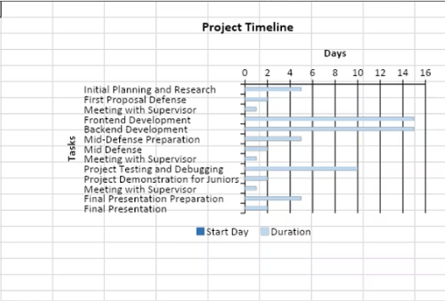
Project Timeline: Gantt Chart

Slide 10
Expected Outcomes
Privacy-Focused
Accurate Self-Tests
Mood Tracker
All data stored locally on user's device.
PHQ-9 and GAD-7 with instant feedback.
History tracking without external sharing.
Engagement
Accessibility
Motivational gallery encourages continued use.
Designed for students and young adults.

Slide 11
Thank You!
Any Questions?

